Slide 1
ALGORITMA PEMROGRAMAN 06. Logika Condition
Teguh Pribadi
http://www.teguhpribadi.com
wa/telegram 0857 3600 3963 || wa/call 082 337 475 885

Slide 2
ALGORITMA PEMROGRAMAN
01. SAP & Pengantar Algoritma dan Pemrograman
02. Dasar-Dasar Algoritma Pemrograman
05. Logika Sequence
06. Logika Condition
09. UTS
03. Dasar Pemrograman Bahasa C++
04. Tipe Data, Variabel, Konstanta, Operator
07. Logika Looping
08. Prosedur dan Function
11. Struktur Data
13. Algoritma Sorting
17. UAS
10. Array
15. Algoritma Search
16. Algoritma Search 2
12. Struktur Data 2
14. Algoritma Sorting 2

Slide 3
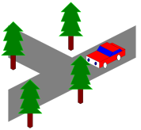
Diaplikasikan untuk penentuan keputusan.
Keputusan didasarkan pada sebuah kondisi.

Slide 4
06. Logika Condition
SE/SI, Flowchart, Pseudocode Condition
Script Condition

Slide 5
1. SE/SI, Flowchart, Pseudocode Condition

Slide 6
SE/SI, Flowchart, Pseudocode Condition
SE/SI
Masukan/input usia
Penentuan kondisi
Jika usia penonton >=17 maka boleh menonton bioskop
Jika tidak maka tidak boleh menonton bioskop
Output boleh atau tidak boleh menonton
PSEUDOCODE
read usia;
if (usia>=17){
print(“boleh menonton bioskop”);
} else {
print(“tidak boleh menonton bioskop”);
}

Slide 7
2. Script Condition
If
If else
If elseif else
Nested if
Switch Case

Slide 8
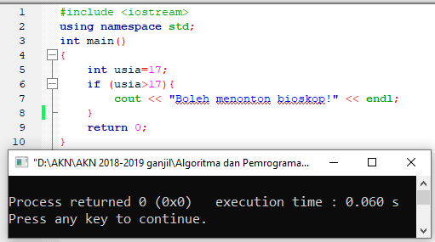
a. If
FLOWCHART
STRUKTUR DASAR
if (kondisi) {
Statement;
}

Slide 9
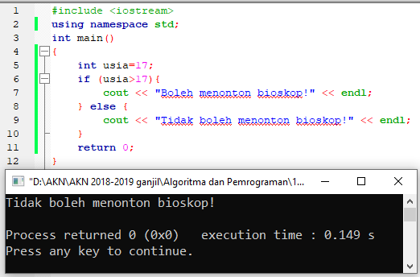
b. If else
STRUKTUR DASAR
if (kondisi) {
Statement1;
} else {
statement2;
}
FLOWCHART

Slide 10
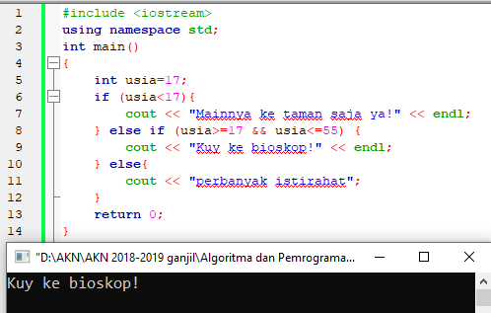
c. If elseif else
FLOWCHART
STRUKTUR DASAR
if (kondisi1) {
statement1.1;
} else if (kondisi2){
statement2.1;
} else{
statement2.2;
}

Slide 11
d. Nested if
STRUKTUR DASAR
if (kondisi1) {
if (kondisi1.1){
Statement1.1;
}else if(kondisi1.2){
statement1.2.1;
}else{
statement1.2.2;
}
}
FLOWCHART

Slide 12
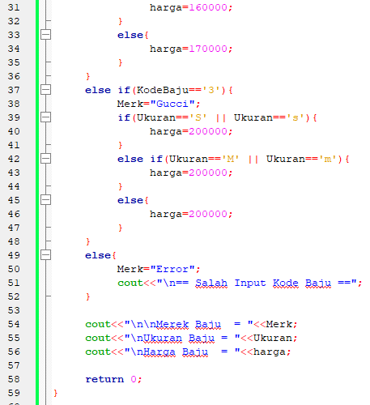
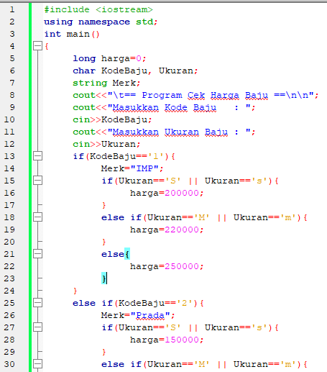
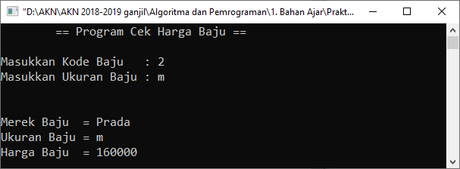
d. Nested if (script)

Slide 13
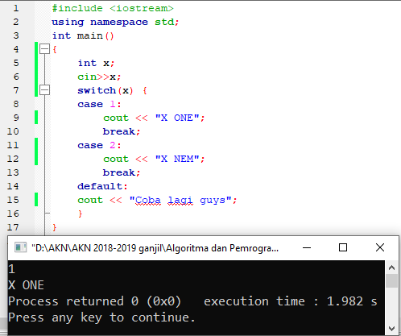
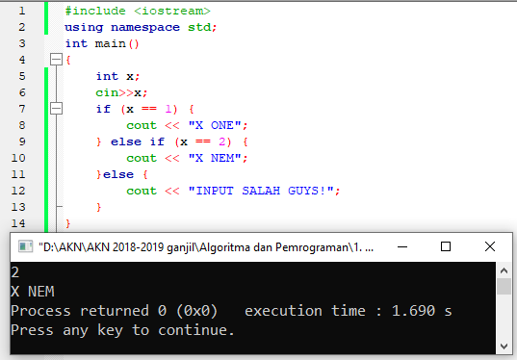
e. Switch Case
FLOWCHART
STRUKTUR DASAR
switch(variabel)
{
case 1 : pernyataan-1;
break;
case 2 : pernyataan-2;
break;
case n : pernyataan-n;
break;
default : pernyataan-m
}

Slide 14
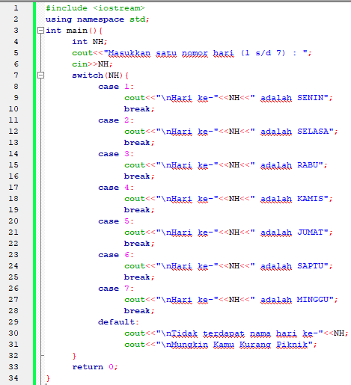
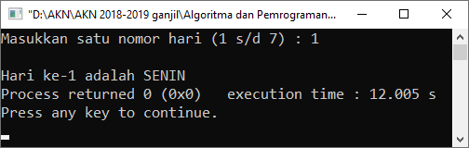
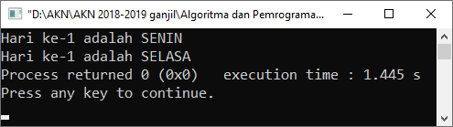
e. Switch Case

Slide 15
Referensi (1)
Dawson, Michael. 2014. Beginning C++ Through Game Programming. USA-Course Technology, a part of Cengage Learning
Fachrurrozi, M. 20. Konsep dan Aplikasi Pemrograman Menggunakan Borland C++ Builder 6
Hendra. 2004. C, C++ Programming
Koening, Andrew and E. Moo, Barbara. 2000. Accelerated-C++. USA-Addison Wesley 387page
Koening, Andrew and E. Moo, Barbara. 2000. Accelerated-C++. USA-Addison Wesley 418page
Liberty, Jesse and Jones, Bradley. 2005. Teach Yourself C++ in 21 Days 5th Edition. USA-Sams Publishing
Meyers, Scott. 2014. Effective Modern C++_ 42 Specific Ways to Improve Your Use of C++11 and C++14. USA-O'Reilly Media
Munir, Rinaldi. 2010. Matematika Diskrit Ed 3. Penerbit Informatika Bandung
Munir, RInaldi. 2011. Algoritma dan Pemrograman dalam Bahasa Pascal dan C
Prata, Stephen. 2005. C++ Primer Plus 5th Edition. USA-Sams Publishing
Prata, Stephen. 2012. C++ Primer Plus 6th Edition. USA-Addison Welley
Randy Davis, Stephen. 2004. C++ For DUMMIES. Indiana,Canada-Wiley Publishing

Slide 16
Referensi (2)
Rao, Siddhartha. 2012. Sams teach yourself C++ in one hour a day 7th edition. Pearson Education
Sebesta, Robert. 2012. Concept of programming languages edisi 10th Addison Wesley Pub
Sethi, Ravi etc. 1986. Compiler Principles, Technique, and Tools. Pearson
Sethi, Ravi etc. 2007. Programing languages consepts and Construcst, addison Wesley 2nd, Publ.
SMK N 1 Cianjur. RPL PEMROGRAMAN DASAR
Stroustrup, Bjarne. 1997. The C++ Programming Language 3rd Edition. Addison-Wesley
Stroustrup, Bjarne. 2013. The C++ Programming Language 4th Edition. Addison-Wesley
Stroustrup, Bjarne. 2014. Programming Principles and Practice Using C++Second Edition. USA-Pearson –full
Stroustrup, Bjarne. 2014. Programming Principles and Practice Using C++Second Edition. USA-Pearson -sample chapter
Suprapto. 2008. Bahasa Pemrograman untuk SMK. Indonesia-DitPSMK
Wibisono, Samuel. 2008. Matematika Diskrit Edisi 2 . Graha Ilmu

